Slide 1
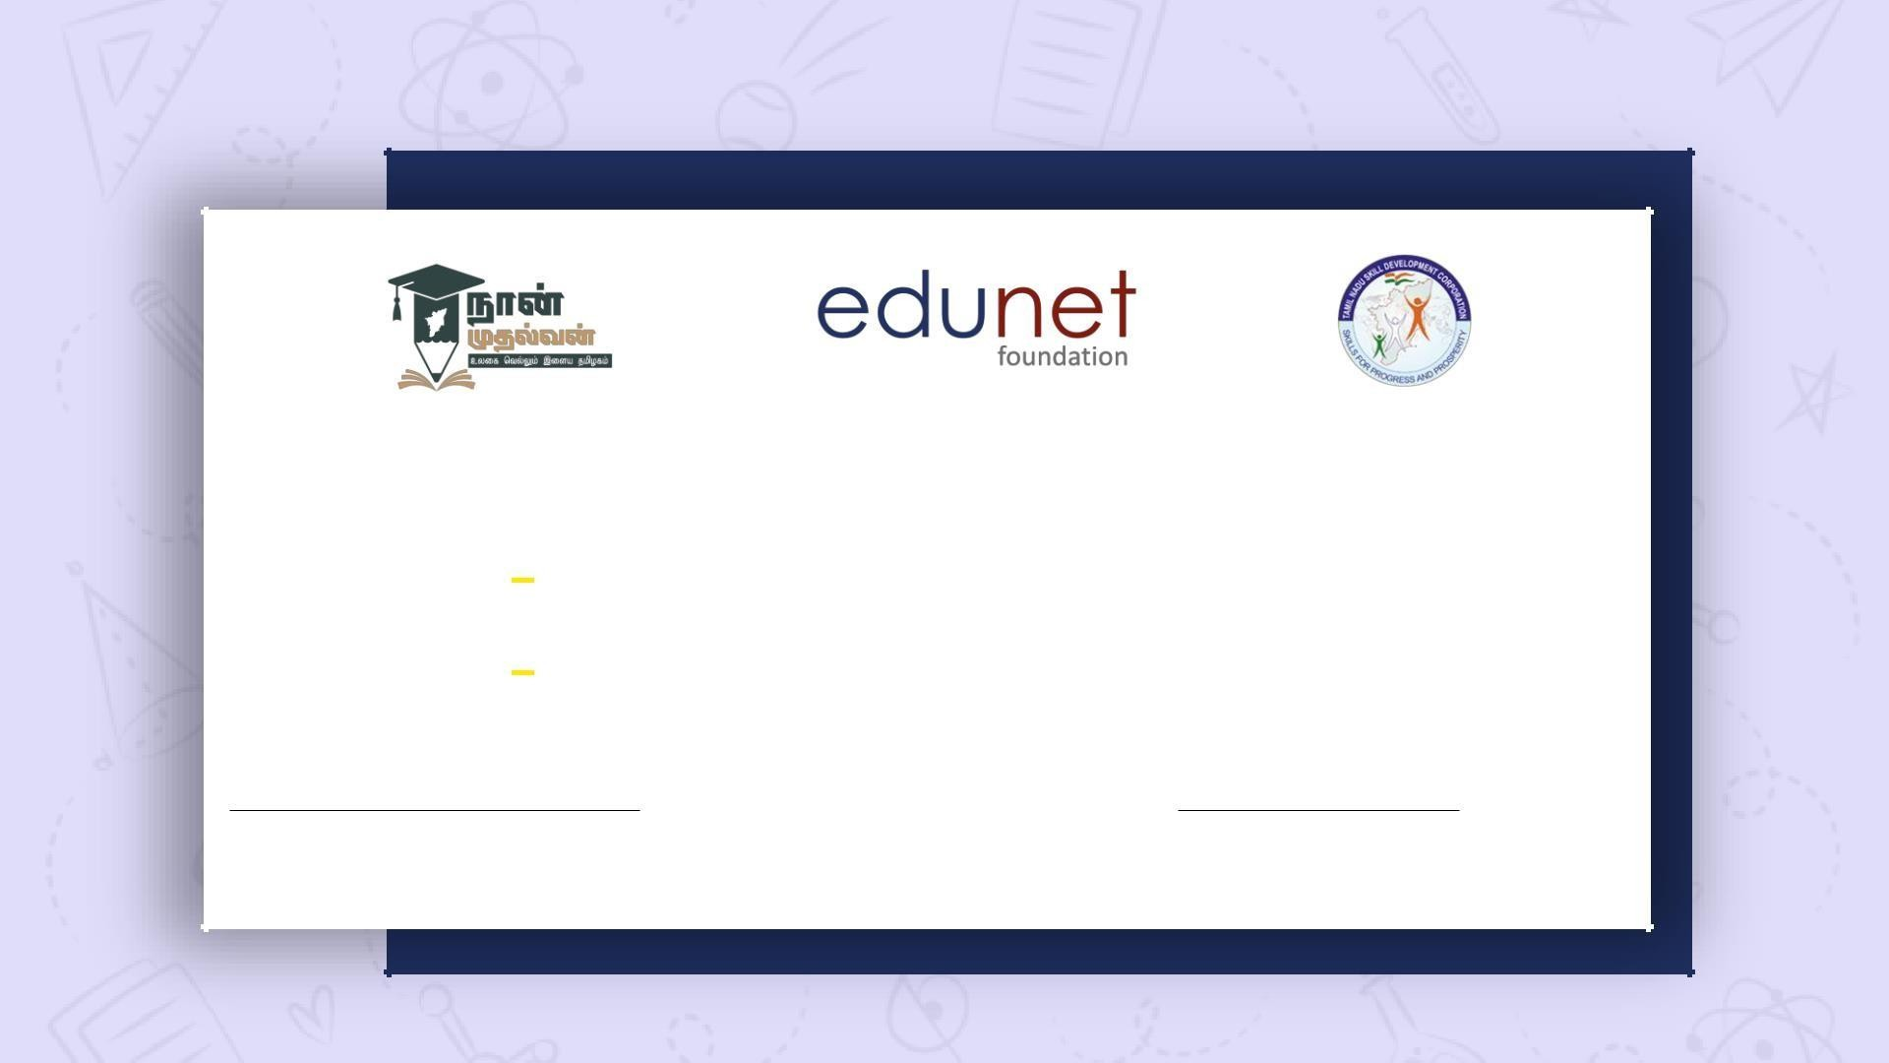
NEXT GEN EMPLOYABILITY PROGRAM
Creating a future-ready workforce
STUDENT DETAILS :
Student Name partha sarathy p
Student ID : au513521104032
COLLEGE NAME :
Annai MiraCollege of Engineering and T echnology

Slide 2

CAPST ONE PROJECT SHOWCASE
Project Title
Bus Reservation System using Python and Django
Abstract | Problem Statement | Project Overview | Proposed Solution |
Technology Used | Modelling & Results | Conclusion

Slide 3
Next Gen Employability Program
Abstract
Purpose:The projectaims to develop a web-based platform that allows users to easily search for available bus routes, select seats, and make reservations online, providing a convenient and efficientway to plan and book bus travel.
Features: The system will include features such as user authentication, bus management (including routes, schedules, and availability), a reservation system with seat selectionand also cancelling the booked buses.
Technology Stack: Built using Python and the Django web framework, the project utilizes Django’s built-in authentication system for user management, and integration with third- party payment gateways for secure transactions.
Objective: By creating an intuitive and user-friendly interface, the project aims to streamline the bus reservation process,enhancing the overall experience for both passengers and bus operators while providing a robust and scalable solution for managing bus reservations online.
Source :

Slide 4
Next Gen Employability Program
Problem Statement
Inefficient Booking Process: Currently, there is a lack of efficient and user-friendly platforms for booking bus tickets online. Existing systems may sufferfrom complicated interfaces,limited availability information, or lack of integration with payment gateways, leading to frustration and inconvenience for users.
ManualManagementfor Bus Operators:Bus operators oftenrely on manual processes for managing routes, schedules, and reservations, leading to inefficiencies, errors, and difficulties in maintaining up-to-date information. There is a need for a centralized, automated system that enables bus operators to efficiently manage their services and improve overall operations.
Lack of Real-Time Updates: Users may face challenges in obtaining real-time updates on bus availability, schedules, and reservations, resulting in uncertainty and inconvenience when planning their travel. A solution is required to provide accurate and timely information to users,enhancing their experience and facilitating smoothertravel planning.
Source :

Slide 5
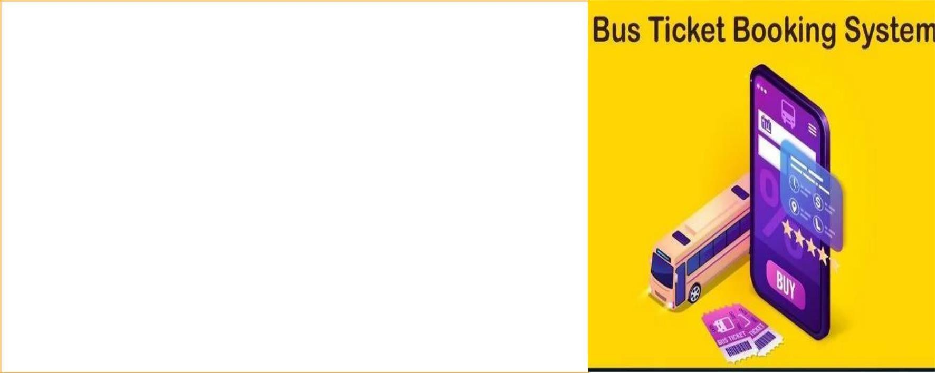
Next Gen Employability Program
Project Overview
Booking Buses Made Easy: We're creating a website where you can easily find and book bus tickets online. No more standing in long lines or struggling with confusingwebsites. Justa fewclicks,and you're all setforyour journey!
Hassle-Free TravelPlanning:Our platform will let you check bus routes, pick your seats, and pay securely online. Say goodbye to last-minute worries about finding a seat or missing out on your preferred bus – we've got you covered!
Convenientfor Bus OperatorsToo: Bus operators will have
an easy time managing their services with our system. They can update schedules, track bookings, and keep everything running smoothly,making travel hassle-free
foreveryone involved.
Source :

Slide 6
Next Gen Employability Program
Proposed Solution
Our Project provides the solution to the problems in Bus Ticket Booking in a simplified and efficient way . Our websitet contains the following features that will make the Bus Booking process very easier
User-Friendly Interface: Develop a clean and intuitive user interface for the website, allowing users to easily search for bus routes, view available schedules,and select seats based on their preferences. The interface should be responsive and accessible across differentdevices.
Comprehensive Bus Database: Create a comprehensive database to store information about buses, routes, schedules,seat availability, and pricing. This database will serve as the backbone of the system, enabling efficientretrieval and management of data.
User Authentication and Profiles: Implement a user authentication system to allow users to create accounts, log in securely, and manage their profiles. Users should be able to view their booking history, update personal information,and manage preferences.
Source :

Slide 7
Next Gen Employability Program
Bus ManagementDashboard:Provide bus operators with a dedicated dashboard to manage their services. This dashboard will allow operators to add new buses, update routes and schedules,manage seat availability, and track bookings in real-time.
Dynamic Seat Selection:Implementa dynamic seat selectionfeature that allows users to view and select available seats on the bus. Users should be able to see which seats are already booked and choose their preferred seating arrangement.
Real-Time Availability Updates:Ensure that seat availability information is updated in real- time to provide users with accurate and up-to-date information. This will prevent overbooking and reduce the likelihood of conflicts during the reservation process.
Secure Payment Integration: Integrate a secure payment gateway to facilitate online transactions for bus reservations. Users should be able to pay using various payment methods, such as credit/debit cards,mobile wallets, or net banking, with confidence in the security of their personaland financial information.
Source :

Slide 8
Next Gen Employability Program
Email Notifications: Set up automated email notifications to confirm bookings,provide booking details, and send reminders about upcoming trips. These notifications will enhance the user experience and keep users informed throughout the reservation process.
Feedback and Support:Include features for users to provide feedbackon their booking experience and seek support in case of any issues or concerns. This will help in continuously improving the platform and addressing any customer inquiries promptly.
Scalability and Performance:Designthe system with scalability and performance in mind to handle a large number of concurrent users and accommodate future growth. Utilize caching mechanisms, optimize database queries, and employ scalable infrastructure to ensure smoothoperation even during peak usage periods.
These features of our website solve the problems in the Bus Ticket Booking process and makes the process more easy and efficient .
Source :

Slide 9

Next Gen Employability Program
Technology Used
Front-end
Back-end
Source :

Slide 10
Next Gen Employability Program
Modelling & Results
MODELLING:
Database Modeling:Utilize Django's ORM to design and implementthe database schema for the project. Define models for buses, routes, schedules, reservations, users, and any other relevant entities. Establish appropriate relationships betweenthese models (such as one-to-many or many-to-many) to accurately represent the data structure.
User Interaction Modeling:Modelthe user interaction flow through wireframes or mockups to visualize the user interface design. Consider the user journey from searching for bus routes to making a reservation and receiving confirmation. Iterate on the designs based on usability testing and feedbackto optimize the user experience.
RESULTS:
User satisfactionon using our website .
Easier way of booking the tickets in the easier and in the efficientway
Source :

Slide 11
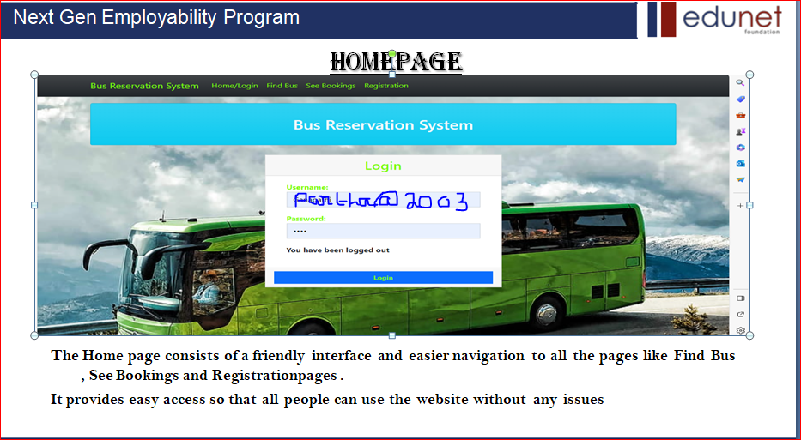
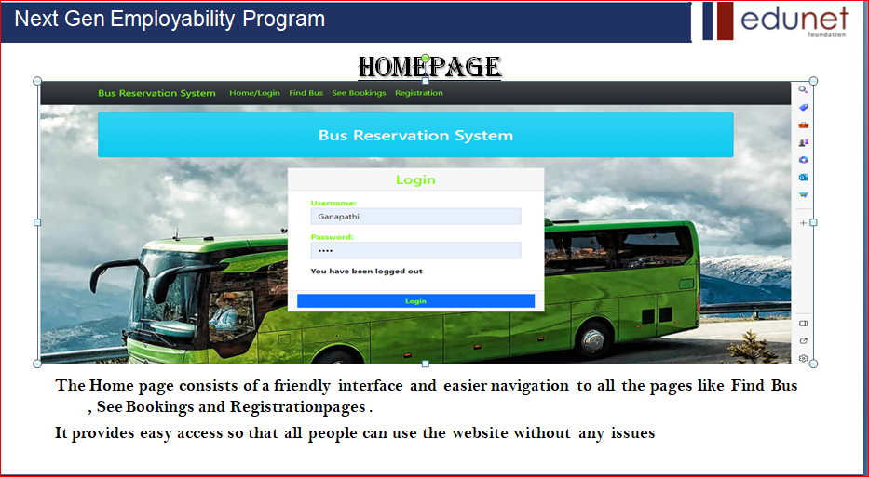
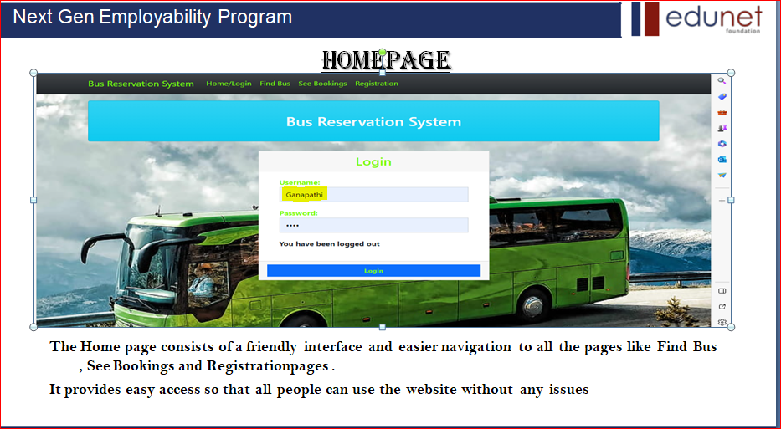


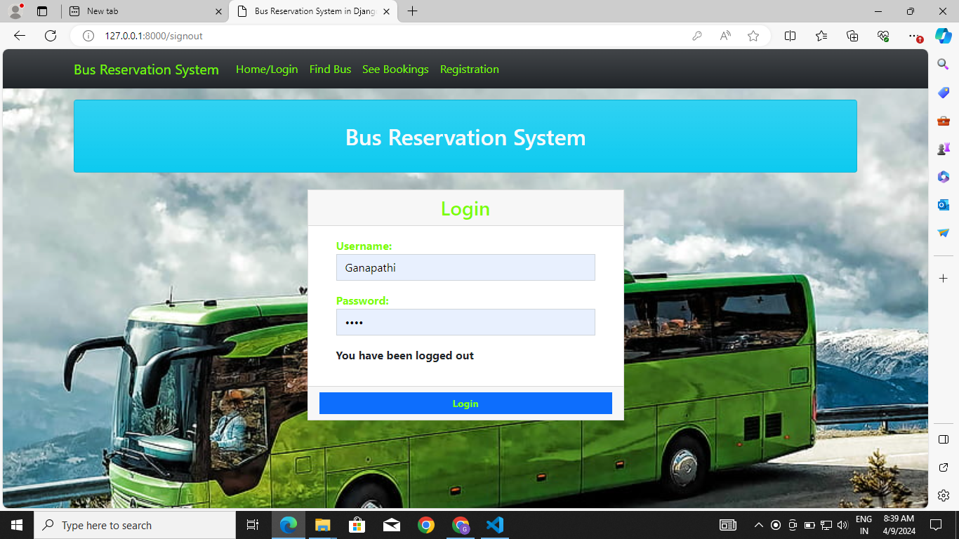
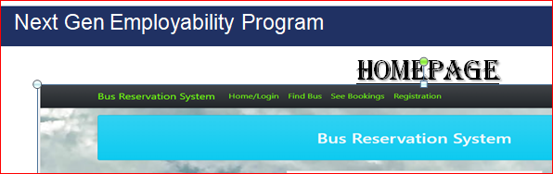
Next Gen Employability Program
Homepage
The Home page consists of a friendly interface and easier navigation to all the pages like Find Bus
, See Bookings and Registrationpages .
It provides easy access so that all people can use the website without any issues

Slide 12
Next Gen Employability Program
About-Us-Page
The About Us page contains the following informations
Provide a brief overview of the company's history, including its founding date, key milestones,and the vision that drives its operations. Communicate the company's mission statement and core values, outlining its commitment to providing convenient, reliable, and affordable bus travel solutions to customers.
Introduce the team behind the online bus reservation platform, including key members such as founders,developers,designers,and customersupportrepresentatives. Share brief bios or profiles
of team members, highlighting their expertise, passion for innovation, and dedication to delivering exceptionalservice to users.
Showcase customer testimonials and success stories to demonstrate the positive impact of the platform on users' travel experiences. Highlight real-life examples of satisfied customers who have benefited fromthe convenience, ease of use, and reliability of the online bus reservation service. Include quotes, photos,or videos to add authenticity and credibility to the testimonials.

Slide 13
Next Gen Employability Program
Service-Page
The sevices page contains the following informations
Booking Services:Provide detailed informationabout the booking services offered through the platform, including the types of bus tickets available (e.g., one-way, round-trip), reservation options (e.g., seat selection, flexible dates), and any special offers or discounts available to customers.
Customer SupportServices:Outline the customersupportservicesprovided to assistusers throughout their journey, such as 24/7 helpline assistance,live chat support, and email support. Highlight the responsiveness, professionalism, and expertise of the customer support team in addressing userinquiries, resolving issues, and ensuring a positive experience for customers.
AdditionalValue-Added Services:Showcase any additional value-added services offered to enhance the overall travel experience for customers, such as travel insurance options, shuttle services,or partner discounts on accommodations and activities. Emphasize the convenience, reliability, and affordability of these services in meeting the diverse needs and preferences of travelers.

Slide 14
Next Gen Employability Program
Departments-Page
The departments page contains the following informations
OperationalDepartments Overview:Provide an overview of the operational departments within the organization, such as the booking department,customerservice department, and technical support department. Explain the role and responsibilities of each department in ensuring the smooth operationof the online bus reservation platform.
TeamMembers and Roles:Highlight the team members associated with each department, along with their respective roles and areas of expertise. This could include departmentheads, managers, supervisors, and staff members responsible for executing day-to-day tasks and providing supportto customers and stakeholders.
Collaboration and Communication Channels:Describe howdifferentdepartments collaborate and communicate with each other to achieve common goals and deliver exceptionalservice to customers. Highlight the communicationchannels used, such as team meetings,project managementtools, and internal messaging platforms,to facilitate seamless coordinationand information sharing across departments.

Slide 15
Next Gen Employability Program
Future Enhancements:
Mobile App Development:Considerdeveloping a mobile app version of the online bus reservationplatform to cater to users who preferto booktickets and manage reservations on their smartphones or tablets. The app could offer additional features such as push notifications for booking updates, GPS tracking of buses in real-time, and seamless integration with mobile payment options for enhanced convenience and accessibility.
Advanced Analytics and Personalization: Implement advanced analytics and machine learning algorithms to analyze user behavior, preferences, and booking patterns. Use this data to personalize the user experience by offering targeted recommendations,customized promotions,and tailored travel suggestions based on individual preferences and past booking history. This could help increase user engagement,loyalty, and conversionrates on the platform.
Integration with Transportation Networks: Explore opportunities to integrate the online bus reservation platform with other transportation networks, such as railways, airlines, and ride-sharing services. This could enable users to seamlesslyplan multi- modal journeys, book connecting tickets, and access integrated travel itineraries through a single platform.

Slide 16
Next Gen Employability Program
Conclusion
Achievements and Milestones:Reflecton the achievements and milestones reached throughout the project development lifecycle. Highlight key accomplishments, such as the successfulimplementationof core features, integration with payment gateways, and deploymentto a production environment.
User Feedback and Impact: Discuss the feedback received from users during beta testing or post-launch surveys. Summarize the overall user experience and satisfaction with the platform, including any areas for improvementidentified by users. Additionally, analyze the impact of the project on facilitating convenient and efficient bus travel booking for users.
Lessons Learned and Future Directions: Share insights gained from the project, including challenges faced,lessons learned,and best practices identified.
Reflecton areas where improvements could be made in future projects or
iterations. Discuss potential future directions for the platform, such as additional features, expansions into new markets, orintegration with othertravel services.
Source :

Slide 17
Thank You!
Next Gen Employability Program

